Slide 1
Music Recommendation system
Comparison of Facial Emotion vs Text-Based Mood Detection

Slide 2
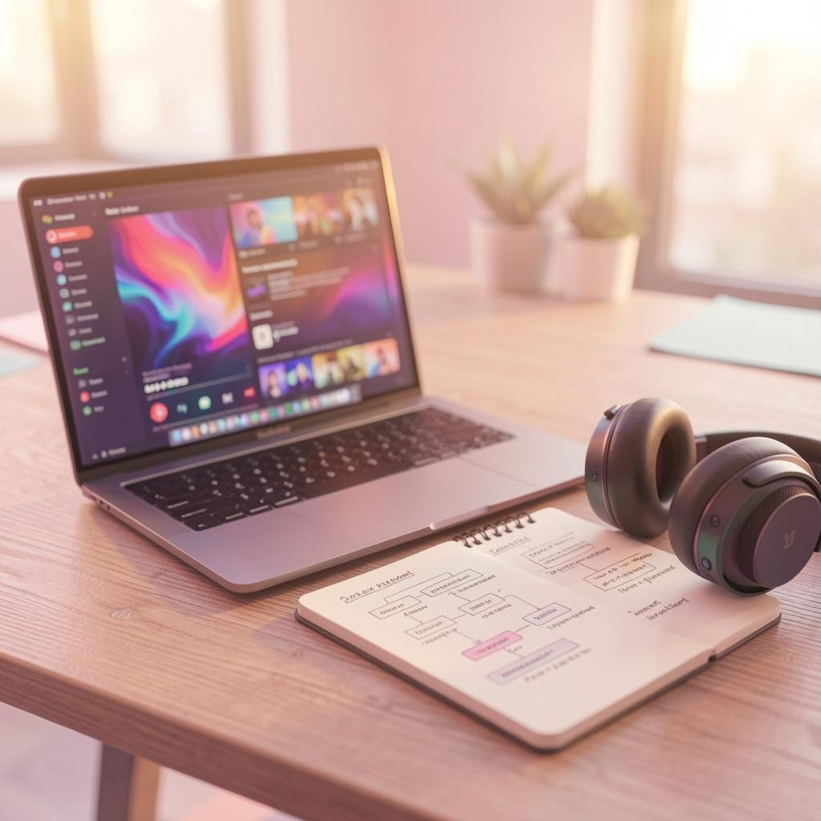
Objectives
- To detect user emotion using facial expressions
- To identify mood from text input
- To recommend songs based on detected emotion
- To compare facial emotion vs text-based mood detection
- To evaluate recommendation accuracy

Slide 3
Real-Time Statistics
- Over 70% users prefer personalized music recommendations
- Music streaming apps like Spotify use AI-based recommendations
- Emotion-aware systems improve user satisfaction by ~30%
- Facial recognition and NLP are widely used in modern AI

Slide 4
Motivation
- Music affects human emotions deeply
- Manual playlist selection is time-consuming
- Need for automatic mood-based music system
- Improve user experience using AI

Slide 5

Existing Systems
- Apps like Spotify and YouTube Music
- Recommendation based on:liListening history
- Popular songs
- User preferences
/li

Slide 6
Issues in Existing Systems
- No real-time emotion detection
- Recommendations not based on current mood
- Lack of personalization
- Cannot detect user feelings instantly

Slide 7
Proposed System
- Detect emotion using:
- Face (camera)
- Text input
- Recommend songs based on emotion
- Compare both methods
- Provide better personalized results

Slide 8

Comparison
- Emotion detection is not available in existing systems, but it is available in the proposed system.
- Real-time mood detection is not supported in existing systems, whereas the proposed system supports it.
- Personalization is limited in existing systems, but it is high in the proposed system.

Slide 9
Sample Input / Output
Input 1 (Face):
→ Happy face
Output:
→ Happy songs list 🎵
Input 2 (Text):
→ “I feel sad”
Output:
→ Sad songs list 🎵

Slide 10
Tools and Dataset Used
Tools:
- Python
- OpenCV
- DeepFace
- Pandas
Dataset:
- Custom CSV file with songs and emotions

Slide 11
Results and Analysis
- Facial detection works automatically
- Text detection depends on user input
- Different recommendations observed
- Combined system gives better results

Slide 12
References
- DeepFace Documentation
- OpenCV Documentation
- Python Official Documentation
- Emotion-Based Music Recommendation (Research Paper)
- Spotify Official Website

Slide 13
Thanks!
Do you have any questions?
youremail@freepik.com
+34 654 321 432
yourwebsite.com
Please keep this slide for attribution

